Slide 1
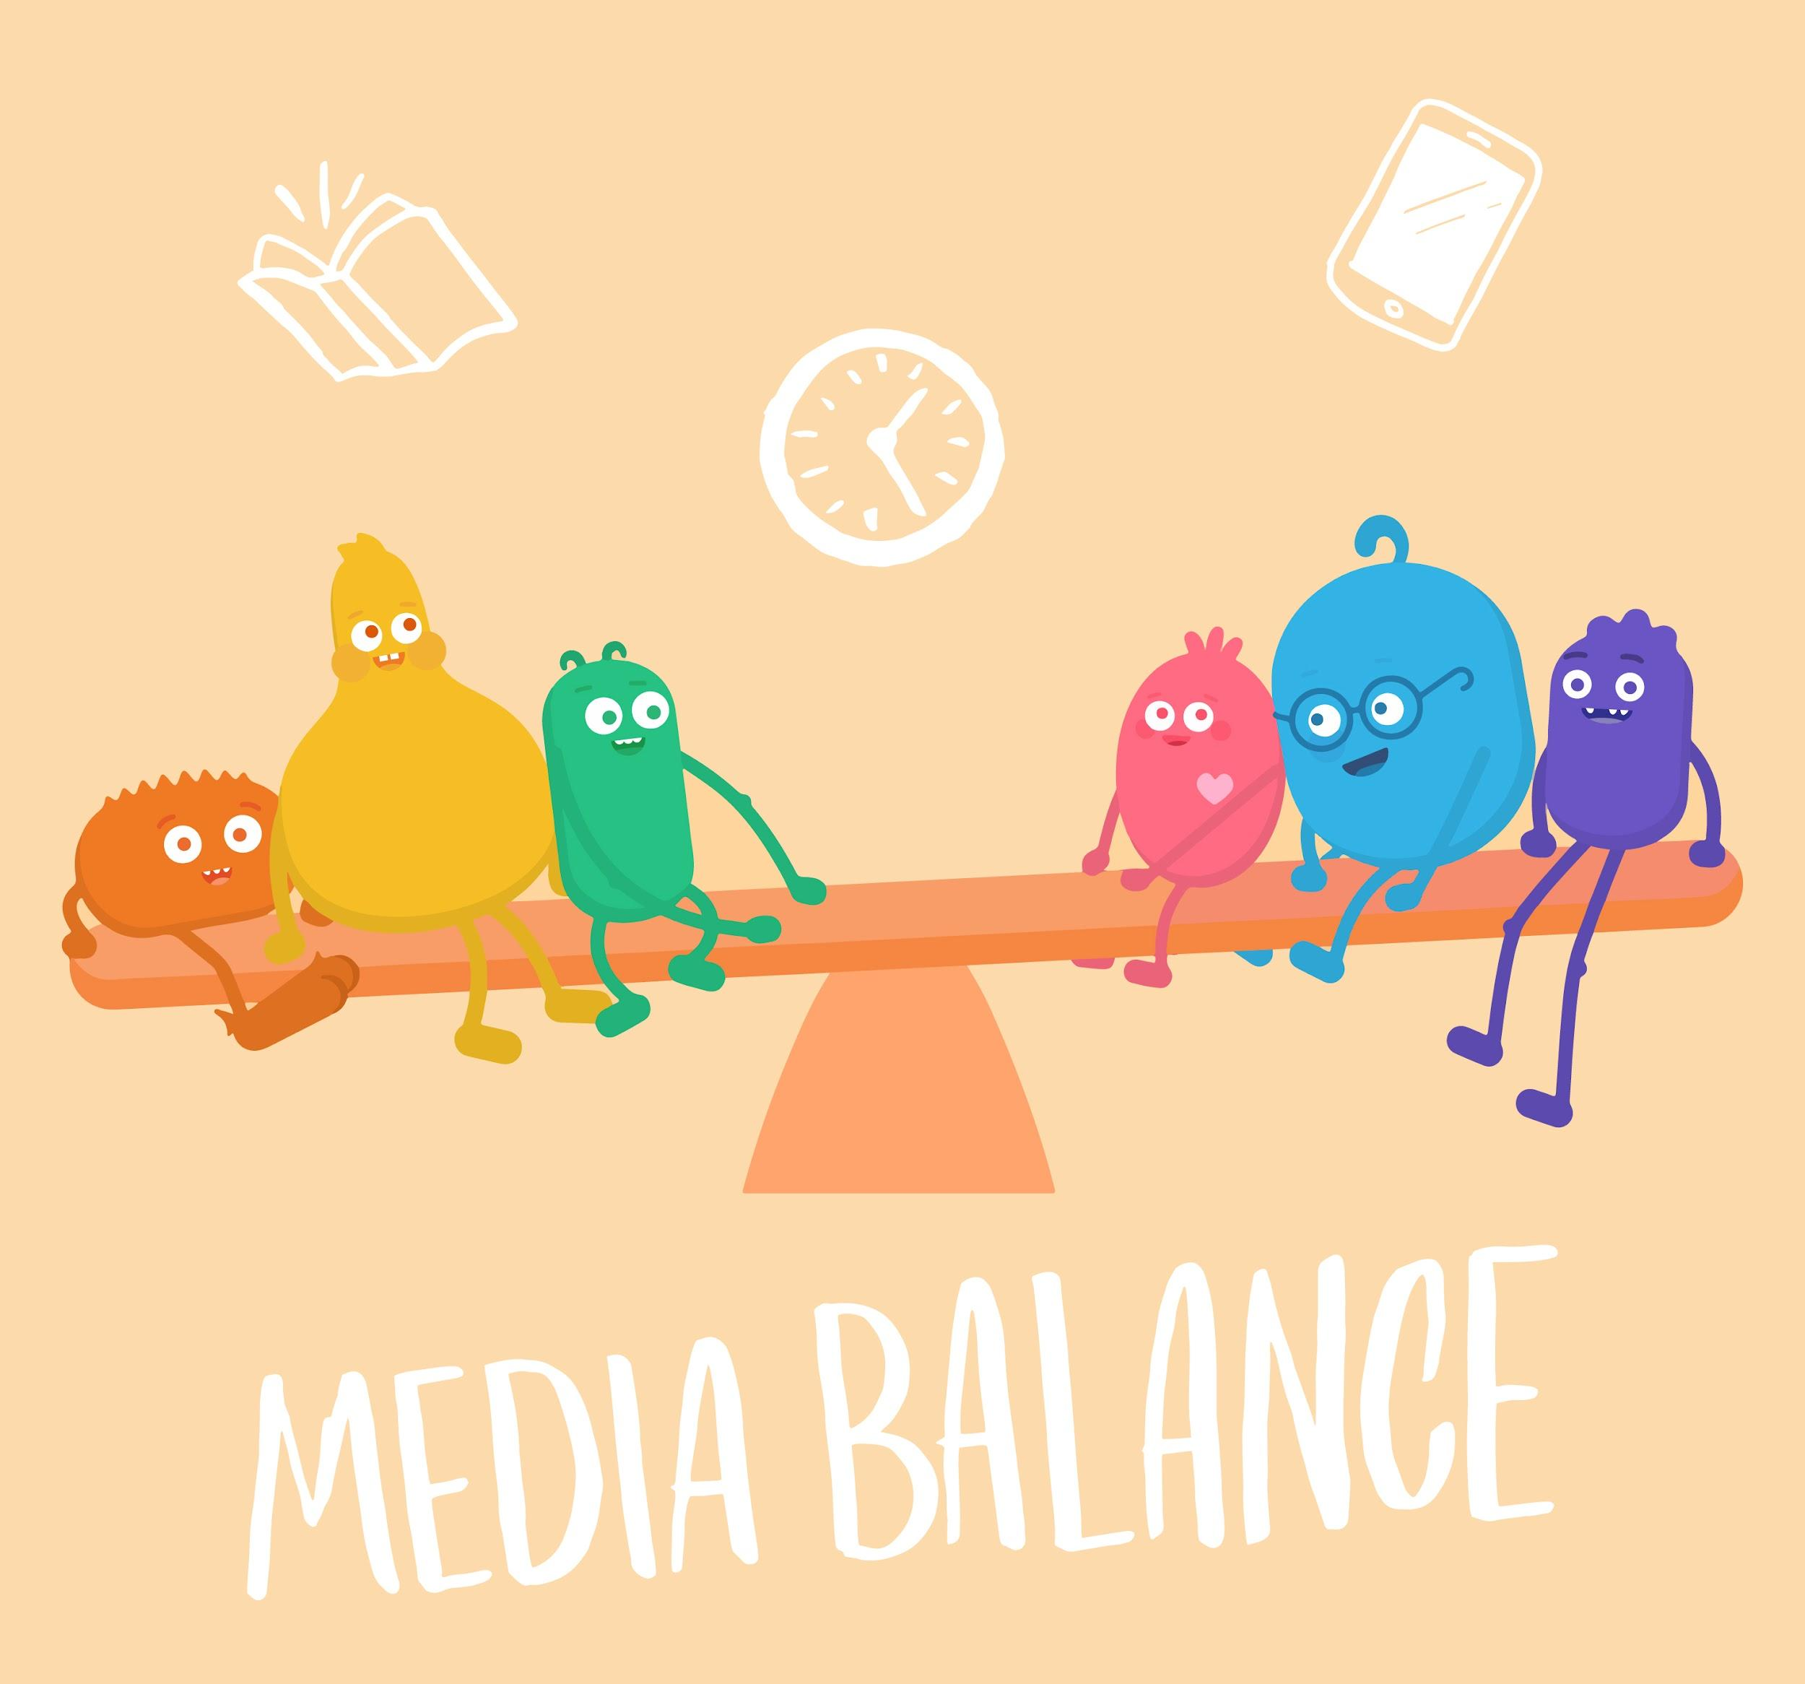

INTRODUCTORY SONG
DIGITAL CITIZENSHIP | GRADE K
Media Balance Is Important

Slide 2
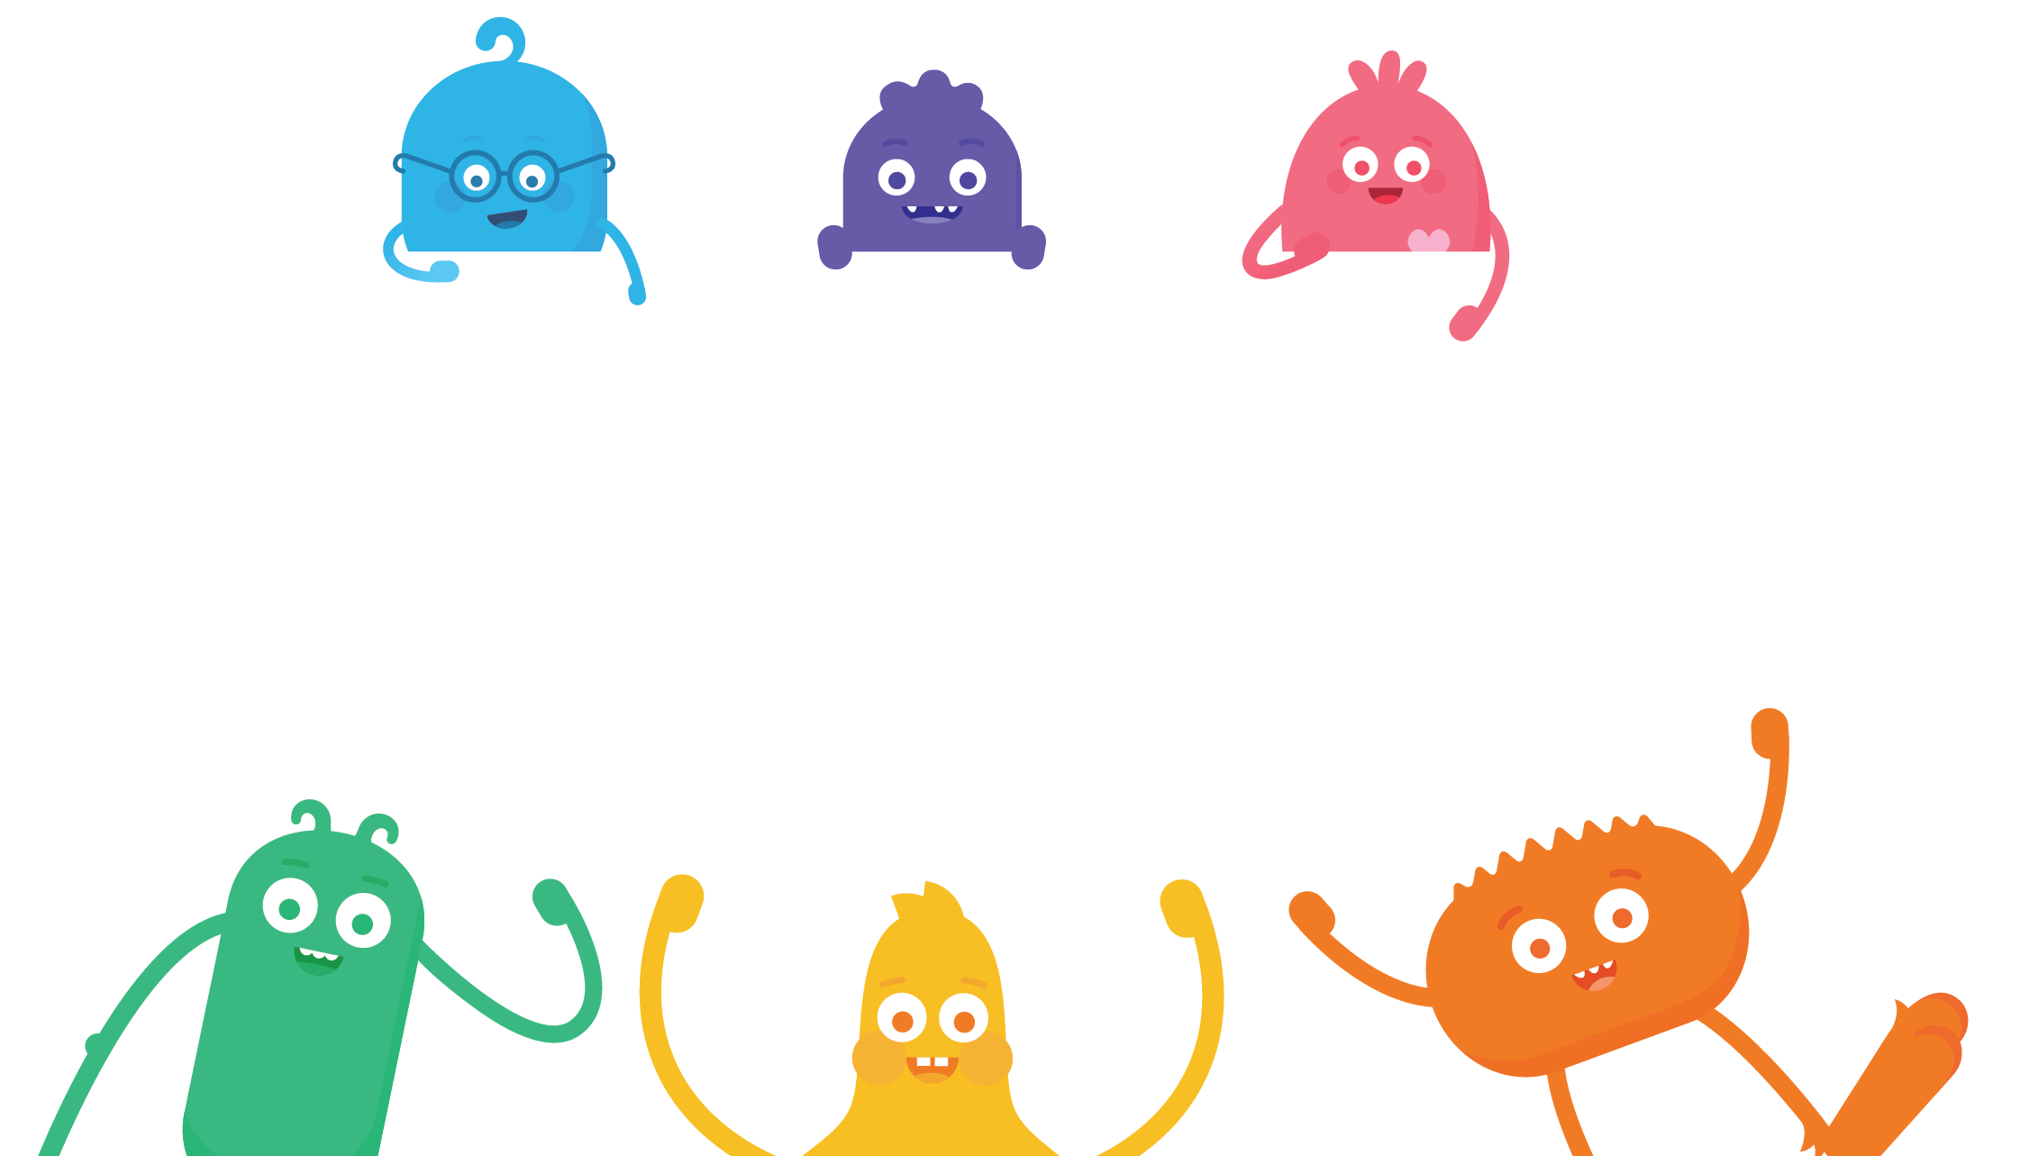

How do we find a
happy balance between our online and offline activities?

Slide 3


REFLECT
Have you ever had the feeling
that you’ve spent too much time using
a device like a tablet or phone?

Slide 4

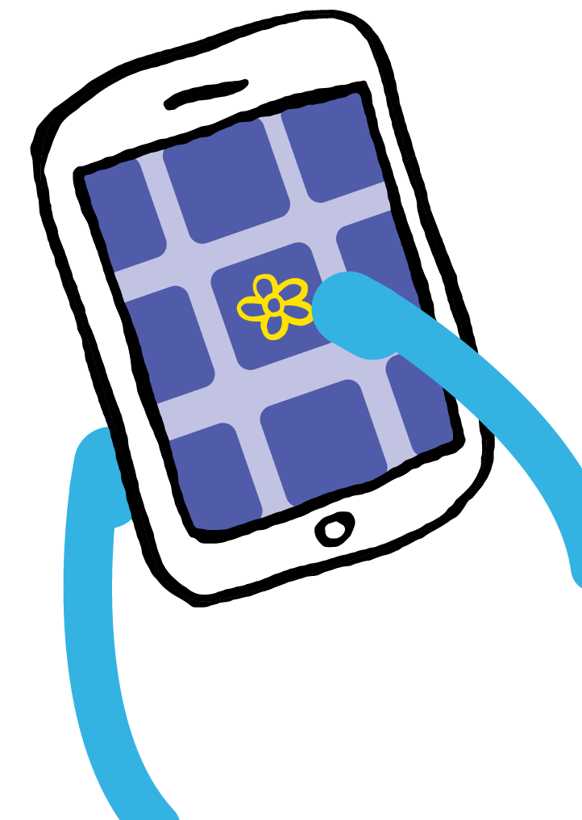

KEY VOCABULARY
Device
An electronic piece of equipment like a phone, tablet, or laptop

Slide 5

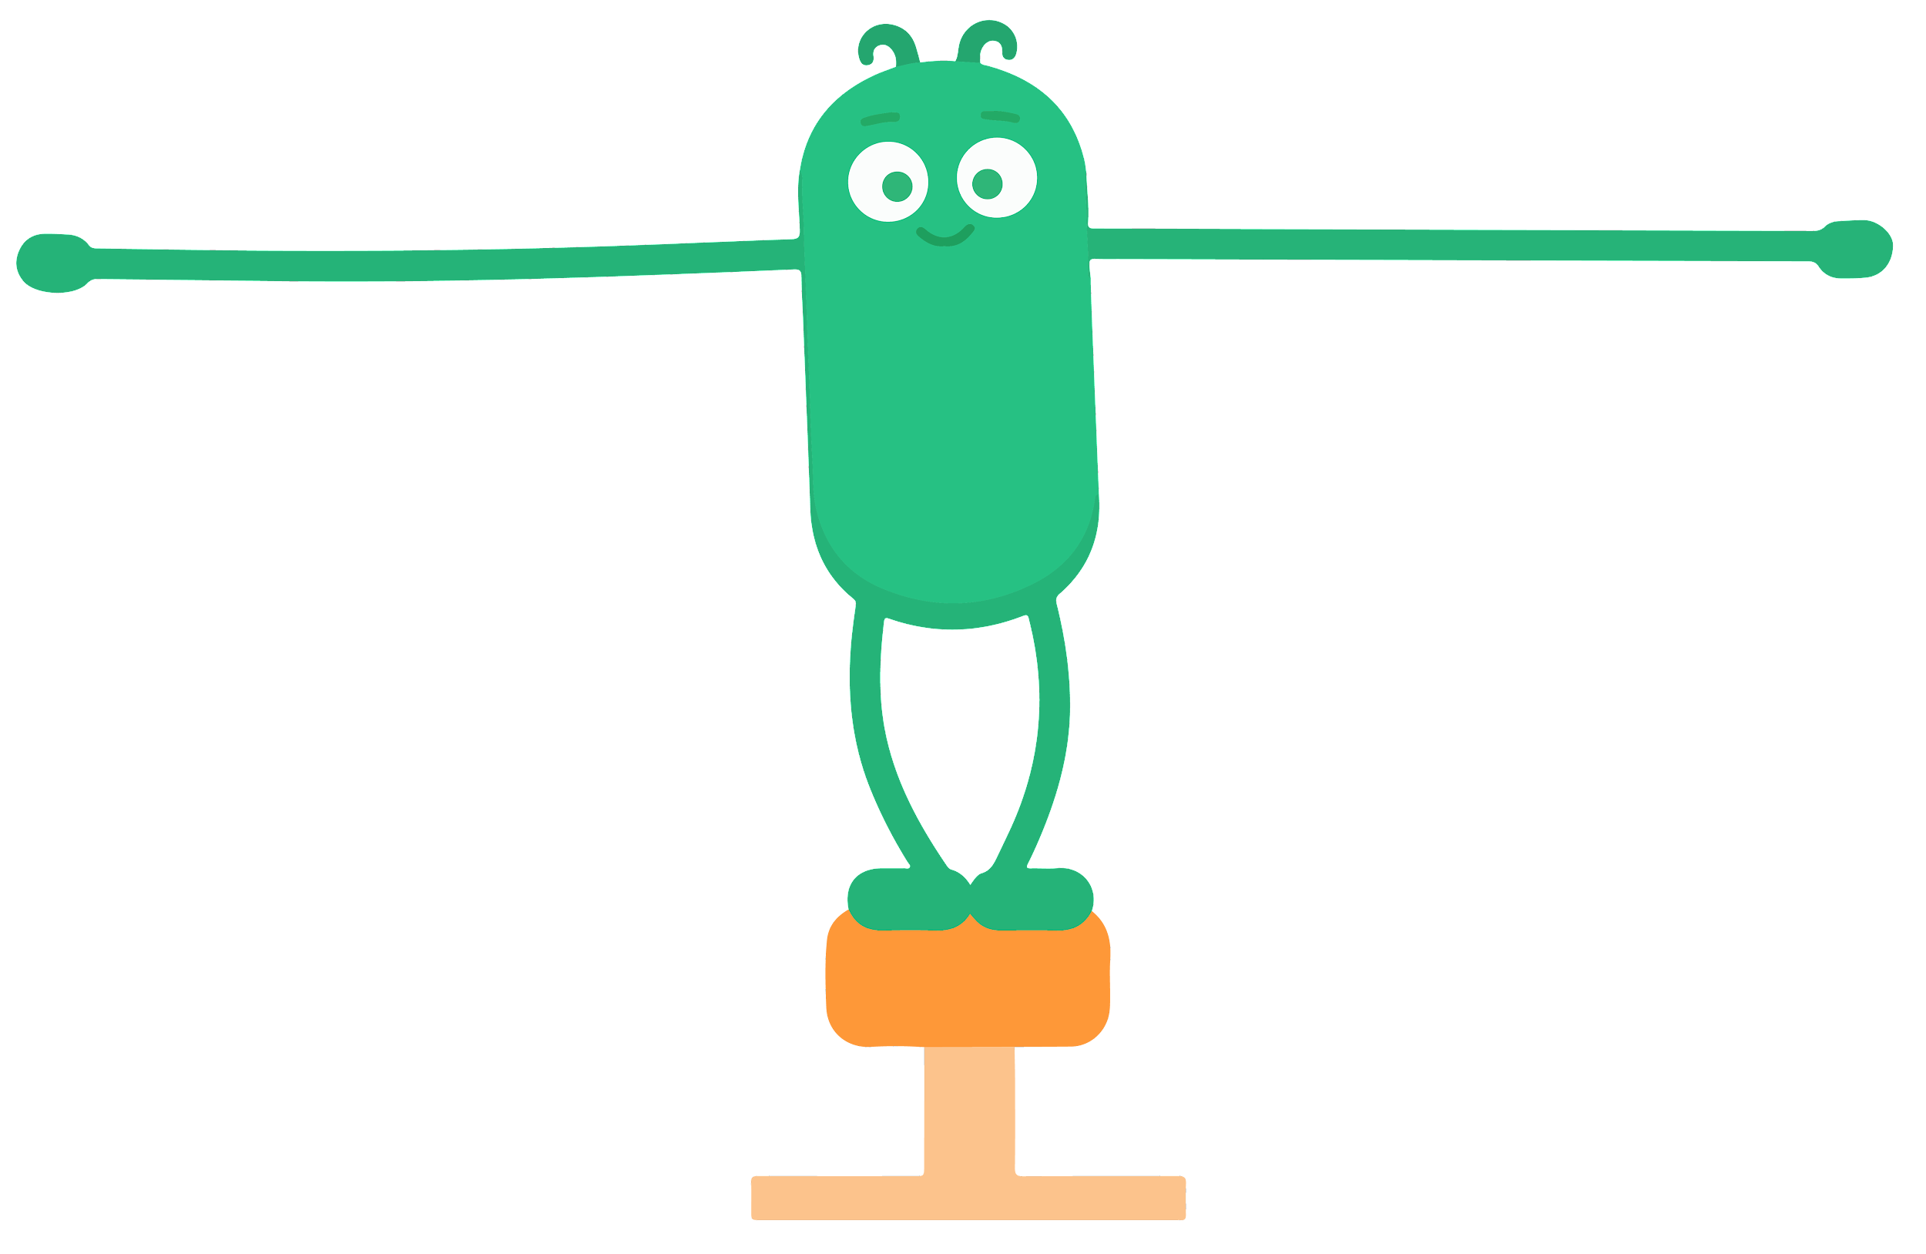

KEY VOCABULARY
Balance
Having equal weight or
importance of something

Slide 6
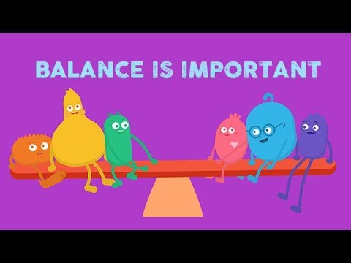
WATCH
To watch this video on the Common Sense Education site, click here.

Slide 7

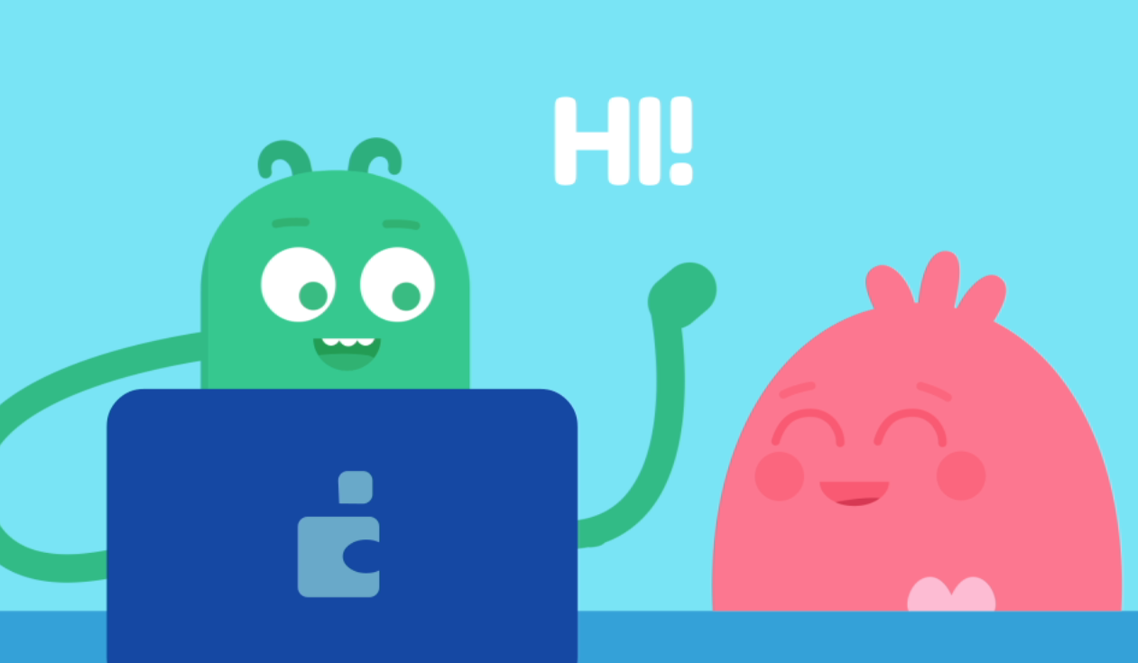
PAIR-SHARE
Why should
you take a
break from
your device when a friend says "hi"?

Slide 8
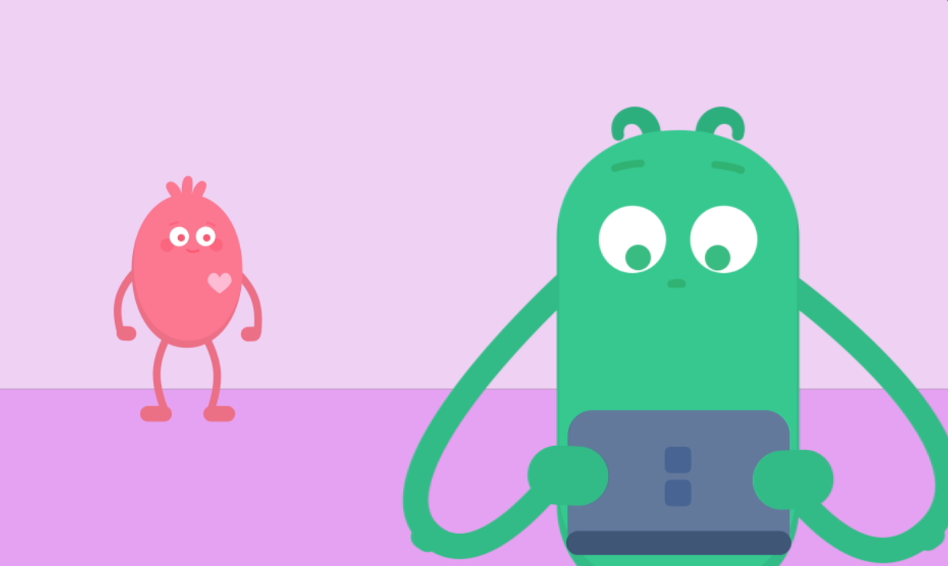
PAIR-SHARE
Why should you invite your friend to play when they are all alone?

Slide 9
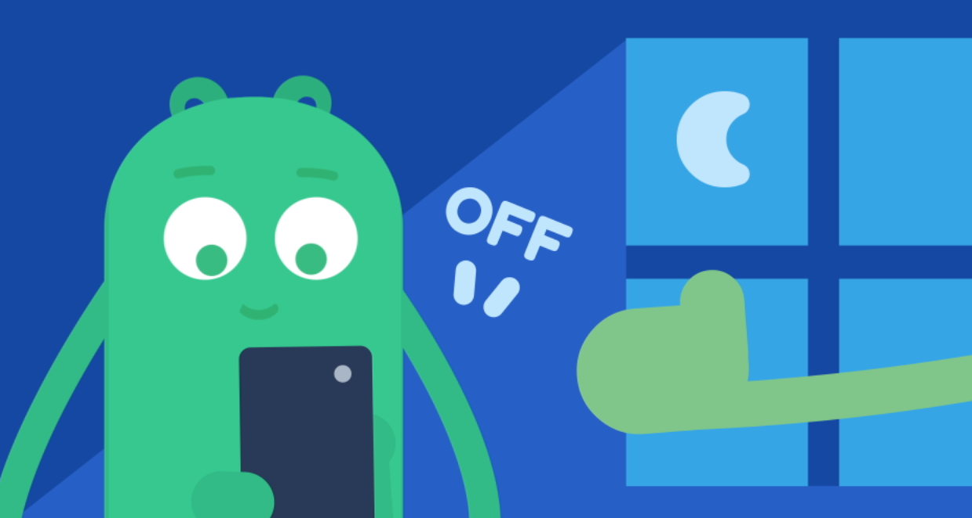
PAIR-SHARE
Why is it a
good idea to turn off your device before going to bed?

Slide 10
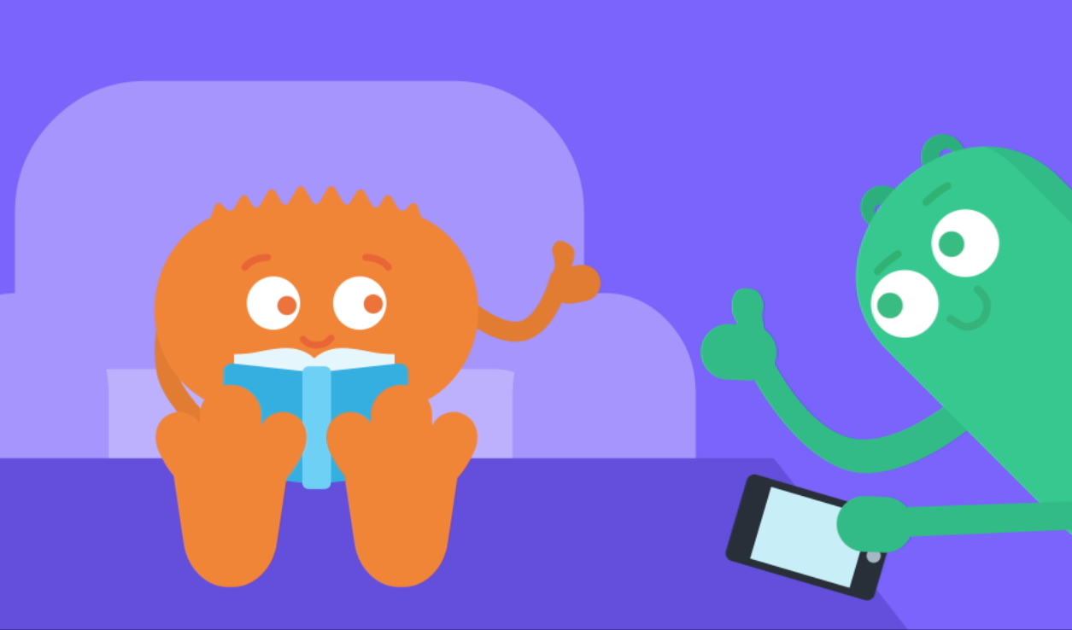
PAIR-SHARE
Why should
you ask permission
before taking
someone’s phone?

Slide 11



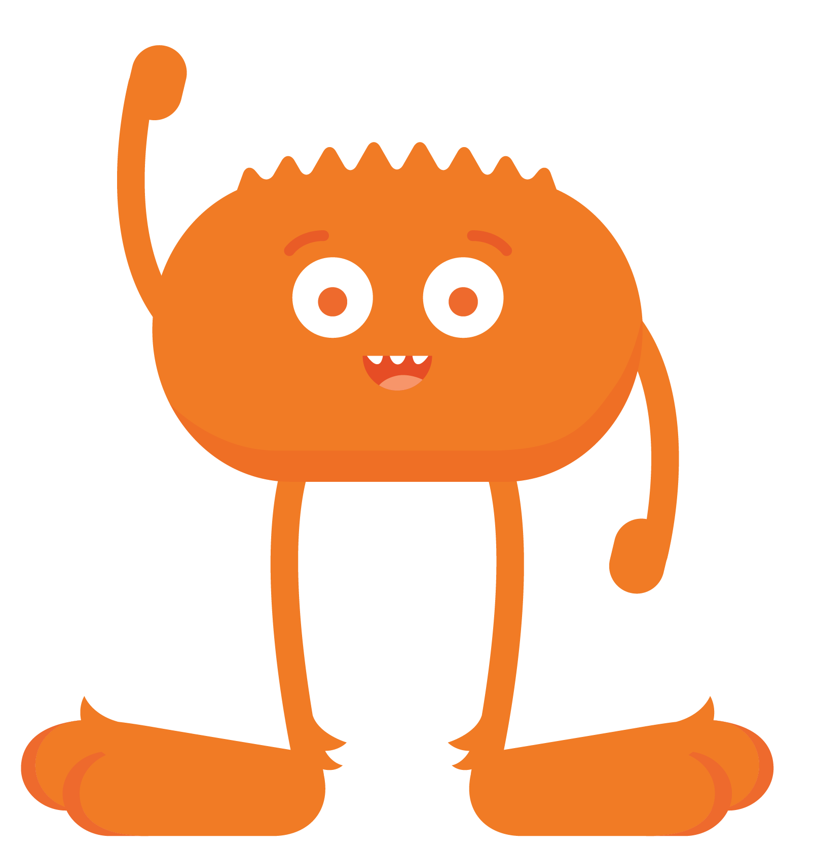




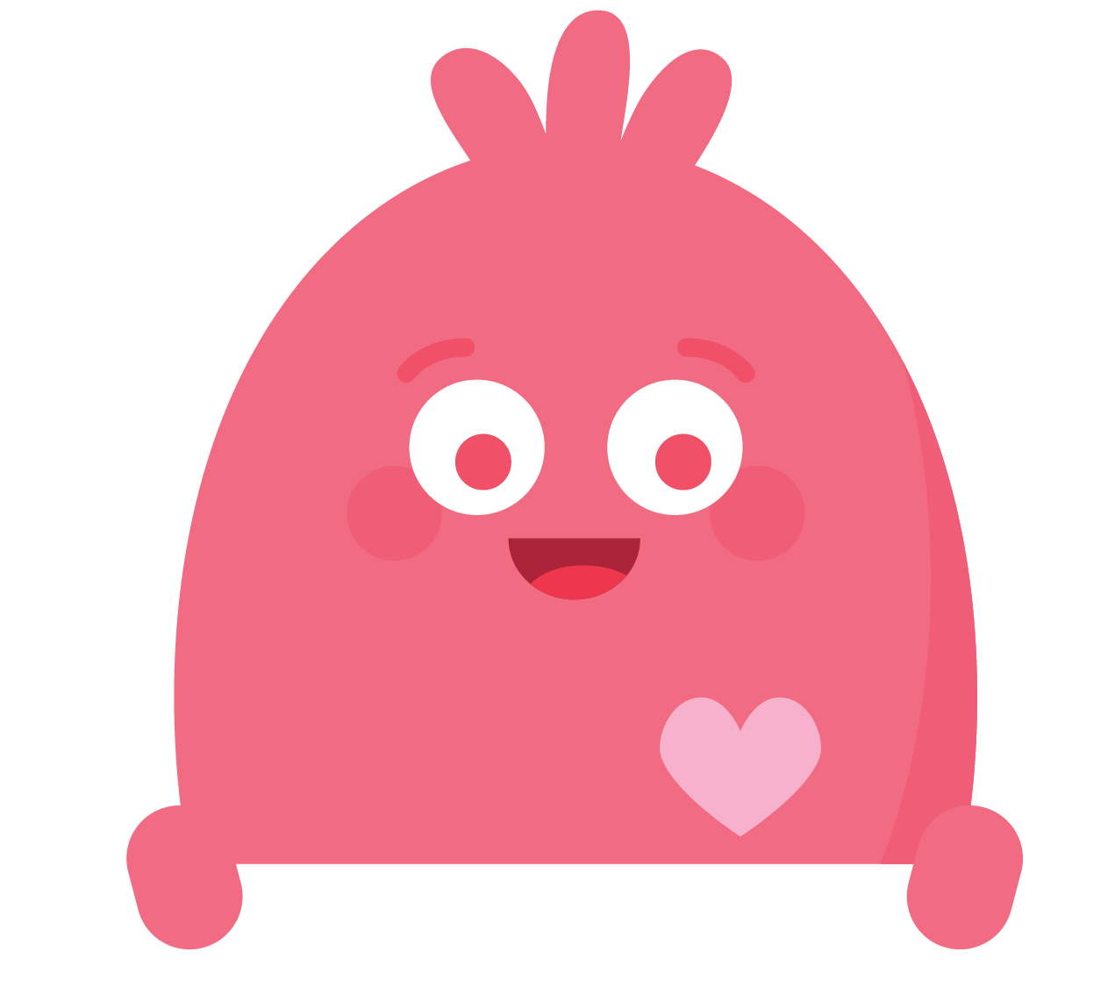
REFLECT HANDOUT
Pause & Think Moment
Draw a picture of what media balance looks like in your life.
and
Write about a time when you like to put your technology away!

